Slide 1

Multi-modal Network Support RAG System - Cisco & Mikrotik (Netaa)
This project introduces an advanced chatbot designed to assist network engineers and technicians in troubleshooting and configuring Cisco and Mikrotik devices. Leveraging Retrieval-Augmented Generation (RAG) and vector databases, the system provides precise and contextually relevant responses to user queries, enhancing network support operations.
Gunjit Arora, NU ID - 002679282 -- Emmanuel Chibua, NU ID - 002799484

Slide 2

Introduction
1
Project Overview
The Multi-modal Network Support RAG System is an advanced chatbot for Cisco and Mikrotik device support.
2
Objectives
Create a responsive chatbot, integrate robust data retrieval, and develop a scalable solution.
3
Relevance
Demonstrates practical application of prompt engineering and AI in solving real-world networking problems.
4
Industry Alignment
Addresses the need for efficient and effective network support solutions using state-of-the-art technologies.

Slide 3
Project Description
System Components
Problem Addressed
Project Scope
The Multi-modal Network Support RAG System combines natural language processing (NLP), vector databases, and RAG to understand and respond to user queries related to Cisco and Mikrotik devices.
The project aims to provide accurate and context-specific support for network configuration and troubleshooting, reducing time and effort required by network engineers.
Initially focused on Cisco and Mikrotik devices, with potential expansion to other network equipment. Supports queries related to device configuration, troubleshooting, and best practices.

Slide 4
Netaa -- where we are!!!
Network Support Chatbot -- with Ollama (llama3) and Streamlit
Network Support RAG System -- with Vector database, Streamlit and GPT-4o
Multi-modal Network-Support RAG System -- with memory, multi-input-output formats, expanded dataset, context management). -- Netaa version 1.0
Netaa version 1.1 -- ?
Netaa version 2.0 -- ?

Slide 5

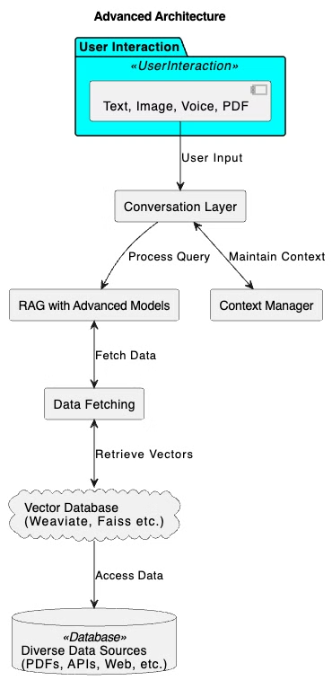




Project Architecture
User Interface
Built using Streamlit for interactive user queries.
NLP Processing
Uses OpenAI's language model to process and understand user inputs.
Vector Database
FAISS is used to store and retrieve documents based on semantic similarity.
RAG Model
Combines retrieved documents with user queries to generate accurate responses.

Slide 6

Data Collection and Preprocessing
1
Data Sourcing
Collected from official Cisco and Mikrotik documentation, technical manuals, and support articles through web scraping and manual collection.
2
Document Conversion
Conversion of collected documents into a uniform format for processing.
3
Text Extraction
Using PyPDFLoader to extract text from PDFs.
4
Text Splitting
Implementing RecursiveCharacterTextSplitter to create manageable chunks.

Slide 7
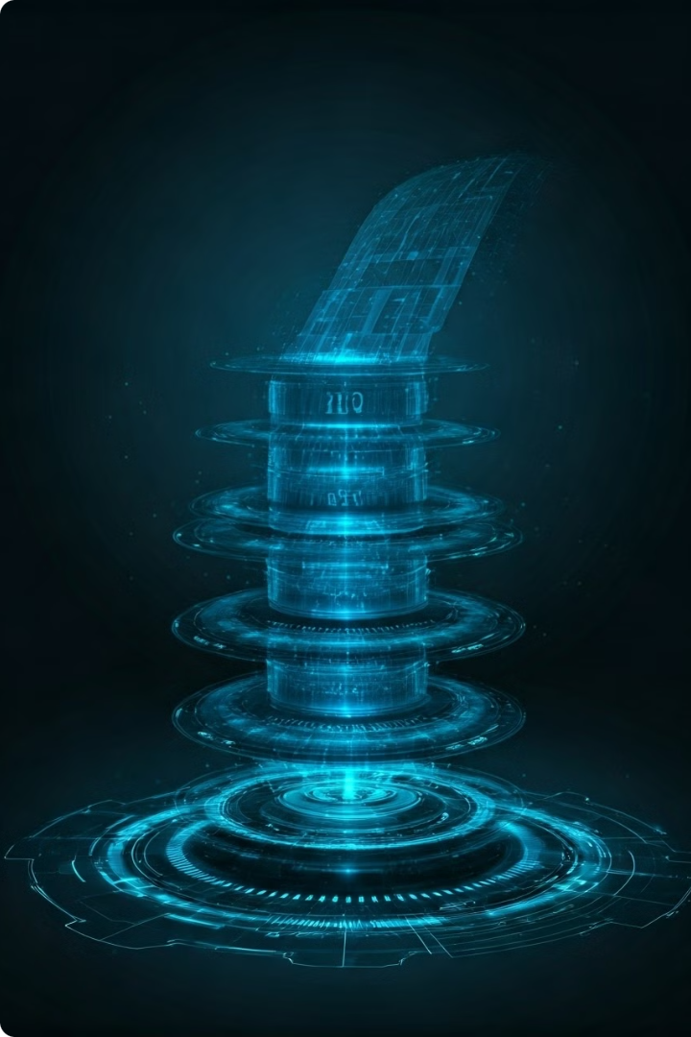
RAG Pipeline Implementation
Data Collection and Preprocessing
Gathering and preparing relevant network documentation.
Indexing
Storing processed text in the vector database for efficient retrieval.
Retrieval
Fetching relevant documents based on user queries.
Response Generation
Creating responses using retrieved documents as context.

Slide 8
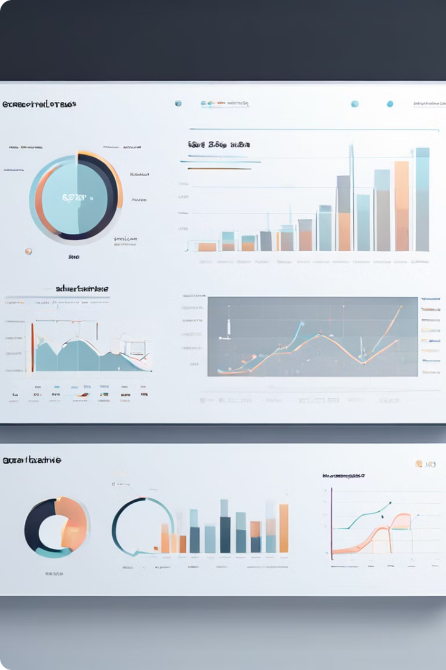
Performance Metrics
Metric
Method Used
Initial Results
Accuracy
Comparison with predefined answers
High accuracy
Response Time
Measuring generation time
Acceptable for real-time
User Satisfaction
Surveys and interaction logs
Positive feedback

Slide 9




Methods to Improve Metrics
Data Enhancement
Expanding dataset with comprehensive documentation to improve accuracy and relevance.
Optimization
Implementing caching mechanisms to reduce retrieval times and enhance user experience.
Continuous Improvement
Model fine-tuning based on user interactions to increase satisfaction and trust.

Slide 10
Deployment Plan
1
Code Finalization
Ensuring all components are integrated and functioning correctly.
2
Cloud Setup
Setting up AWS, Google Cloud, or Oracle Cloud Infrastructure for hosting.
3
Containerization
Using Docker for efficient deployment and scaling.
4
CI/CD Implementation
Implementing GitHub Actions for continuous integration and deployment.
5
Beta Testing
Conducting user testing with network engineers and collecting feedback.

Slide 11
Netaa -- Our future
Network Support Chatbot -- with Ollama (llama3) and Streamlit
Network Support RAG System -- with Vector database, Streamlit and GPT-4o
Multi-modal Network-Support RAG System -- with memory, multi-input-output formats, expanded dataset, context management). -- Netaa version 1.0
Netaa version 1.1 -- Highly adaptive RAG system with fine-tuned LLM model
Netaa version 2.0 -- Full scale enterprise RAG systems with fine-tuned LLM models for specific fields.

Slide 12
Future Work and Conclusion
Future Extensions
Key Takeaways
Final Thoughts
Adding support for other manufacturers, incorporating multimedia, developing a mobile app, and integrating with enterprise network management systems (ServiceNow, Jira).
The project demonstrates practical AI application in network support and highlights the importance of accurate, contextual information in troubleshooting and configuration tasks.
This project showcases AI's potential in enhancing technical support and operational efficiency. We invite questions from the audience about the Multi-modal Network Support RAG System.

Slide 13
Ask Me Anything 😃

